Slide 1
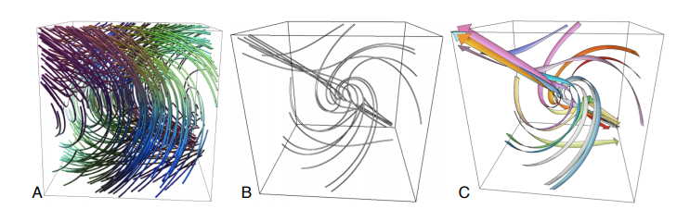
An Illustrative Visualization Framework for 3D Vector Fields
Cheng-Kai Chen, Shi Yan, Hongfeng Yu, Nelson Max, Kwan-Liu Ma
By: Michael Tran
COSC 6344 – Visualization
11/30/2018

Slide 2
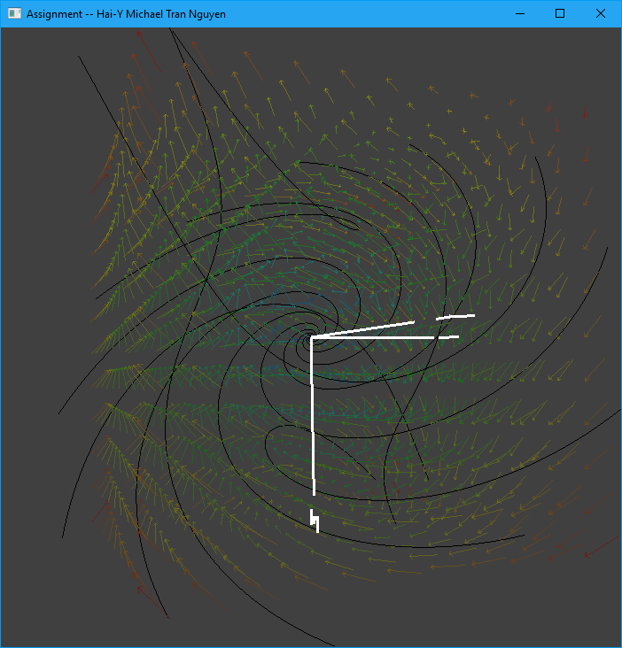
Goals
Recall: Assignment 7…
Instead of manually choosing seed locations or using stream/stream ribbon probes, we want to seed and visualize automatically.

Slide 3
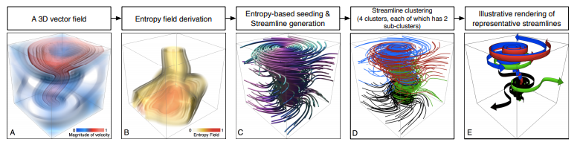
Overview
Entropy-Based Seeding
Histogram/Binning, Entropy Calculations, Seeding
Two-Stage Streamline Clustering
K-means Algorithm on Vector Spatial Properties
K-means Algorithm on Vector Shape Properties
Streamtape Generation
Binormal Vector, Tangent Vectors, Normal Vectors, Torsion

Slide 4
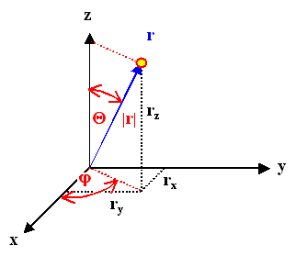


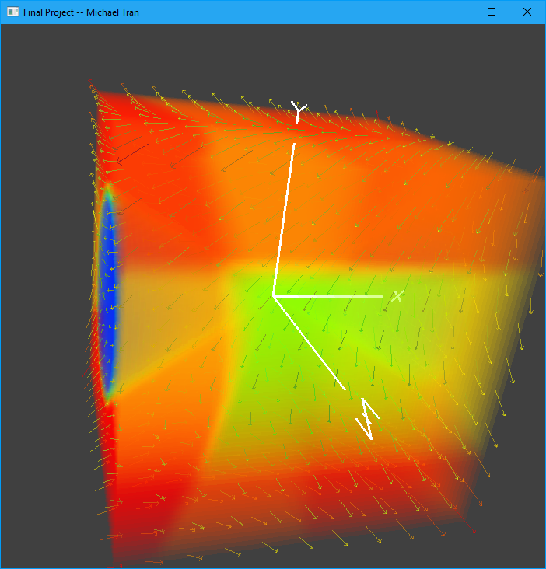
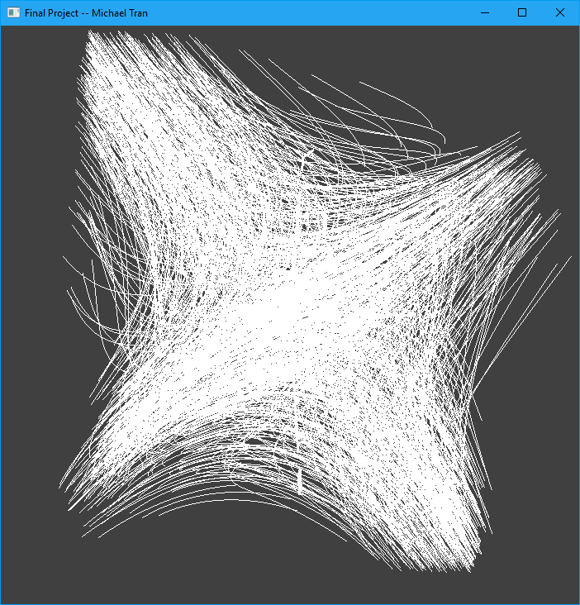
Entropy-Based Seeding
To calculate Entropy:
Bin each voxel in the vector field depending on Phi (φ) and Theta (θ).
Calculate Probability in each voxel:
Calculate Entropy in each voxel using a 3x3x3 neighborhood as reference:
Shuffle all points and choose 1000 random points
Give a point with higher entropy a higher chance of being chosen.

Slide 5
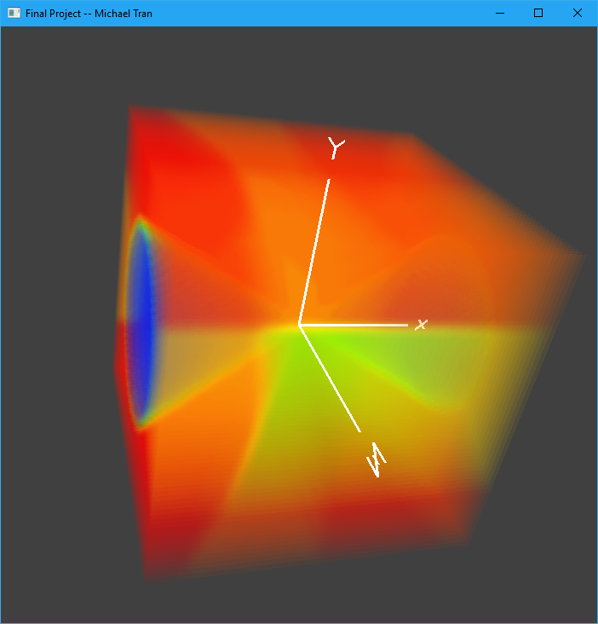
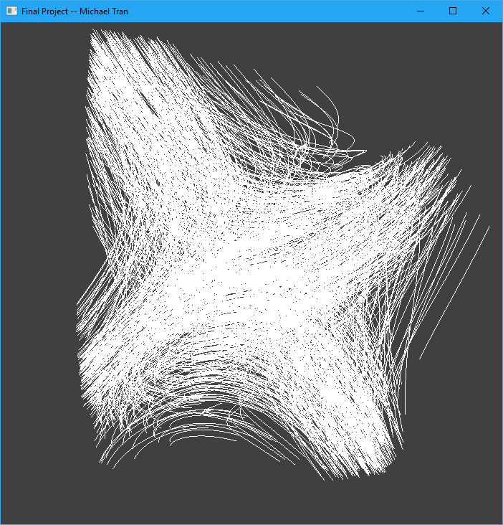
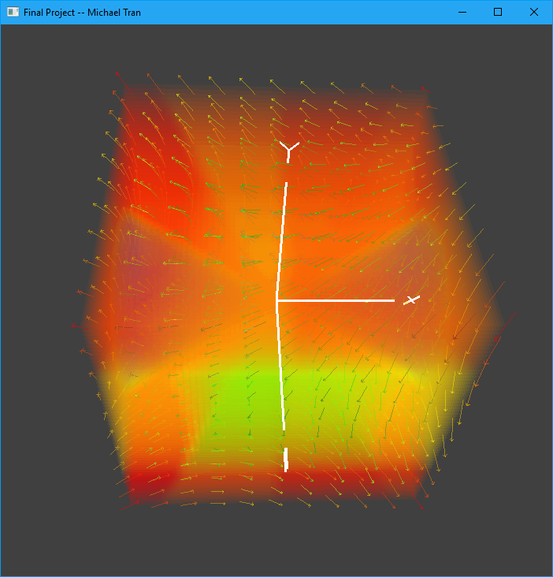
Entropy-Based Seeding - Results
Entropy Field
1000 Seeds Picked Based on Entropy Field

Slide 6
Streamline Clustering
To cluster properly, we cluster two times – cluster all streamlines, and then cluster again on the clusters from the previous clustering.
To cluster, we employ the k-means clustering algorithm based on certain vector properties.
https://en.wikipedia.org/wiki/K-means_clustering

Slide 7
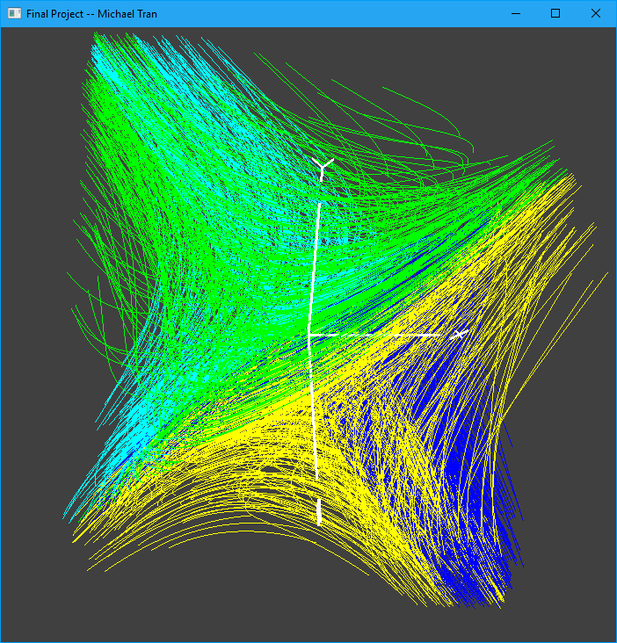
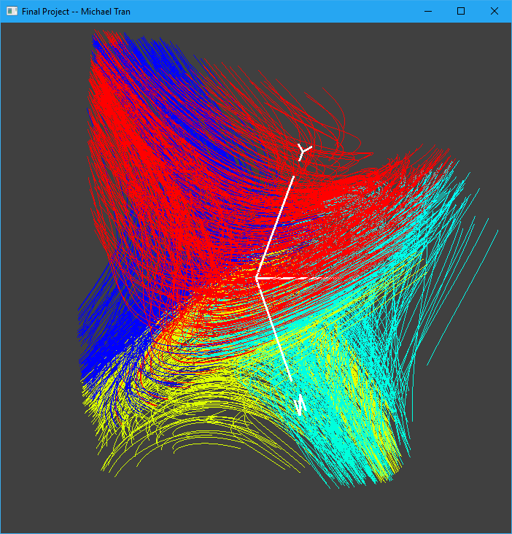
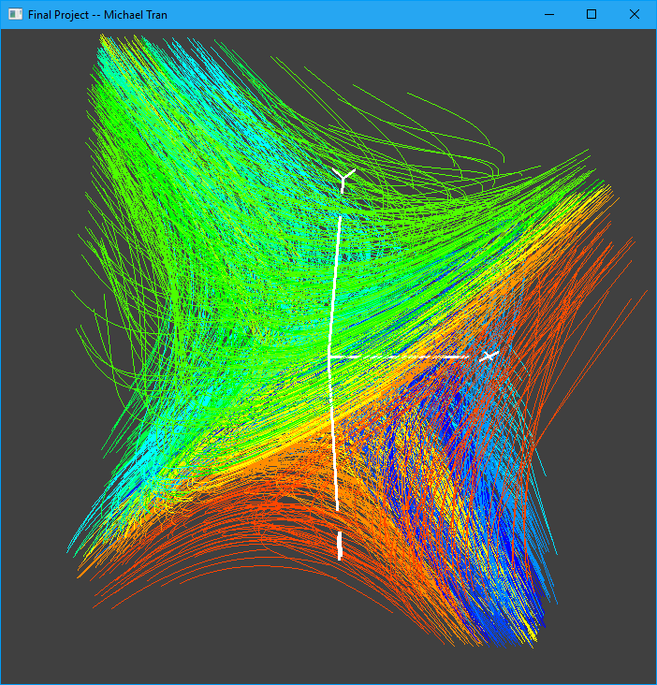
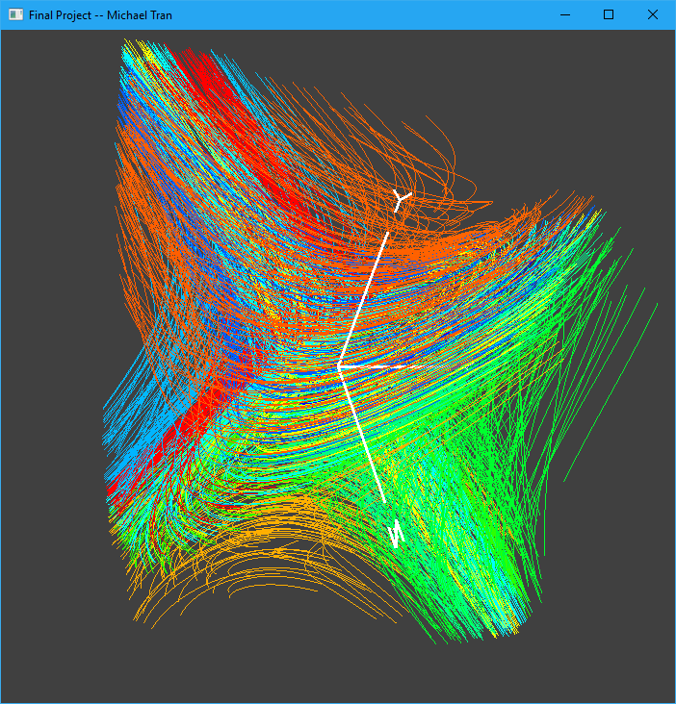


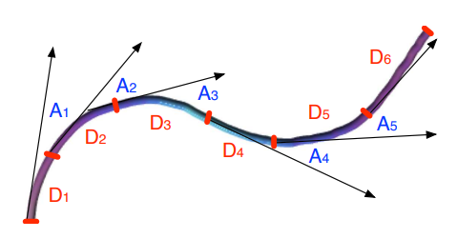
K-means Algorithm
First Stage: K-means Algorithm on Vector Spatial Properties
For the first clustering we take the streamline start/mid/end point as our clustering property.
Second Stage: K-means Algorithm on Vector Shape Properties
We take the clusters from the first stage and apply K-means algorithm again on each cluster. We use Linear Entropy (EL) and Angular Entropy (EA) as our clustering property.

Slide 8
Streamline Clustering - Results
Stage 1 Clustering
Stage 2 Clustering

Slide 9
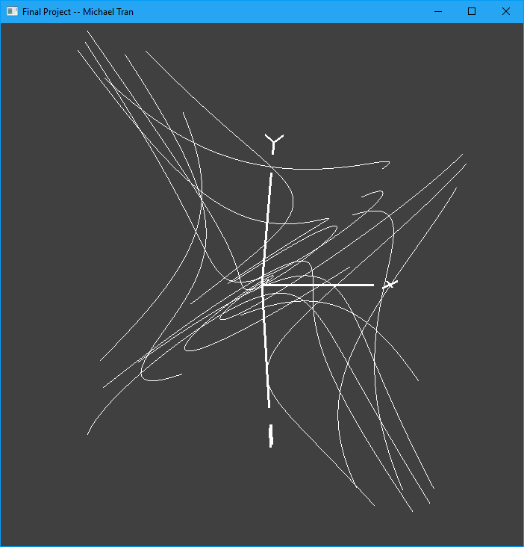
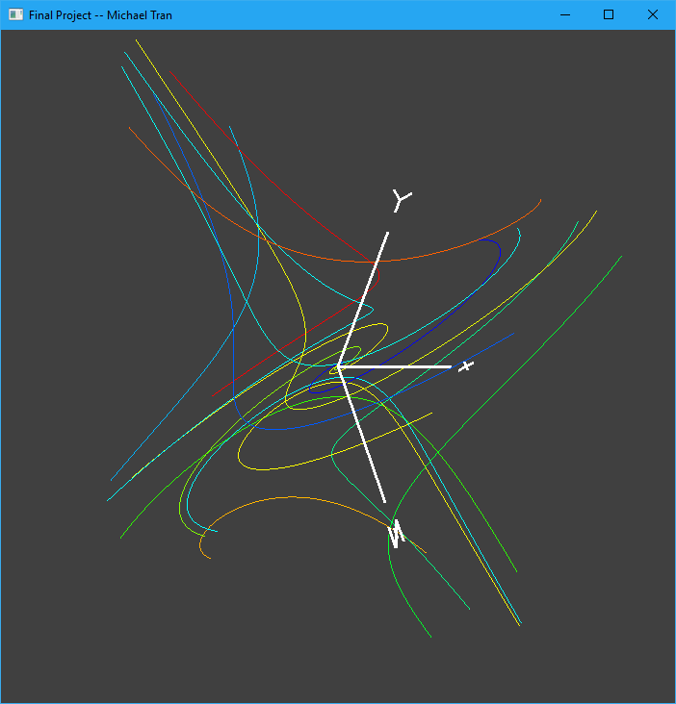
Streamline Clustering – Bundling
After all streamlines are clustered, we pick the streamline closest to each centroid as the candidate streamline.
Stage 2 - Clustering
Bundled Streamlines

Slide 10
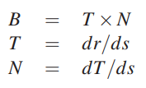


Streamtape Generation
At each point on a streamline, we calculate the following variables:
Binormal Vector B, Tangent Vector V, Normal Vector N, Torsion τ, Width ω
r’, r’’, r’’’ are the first, second, and third derivatives of r(s) (the streamline).
Once we have the values, we can render the stream tape.

Slide 11
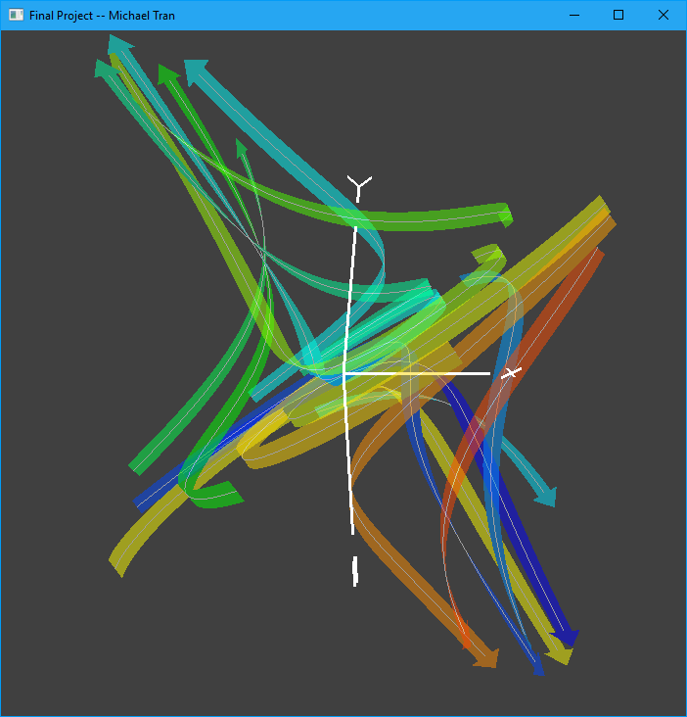
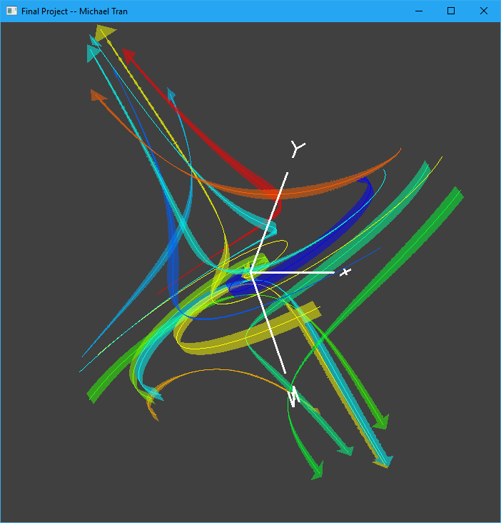
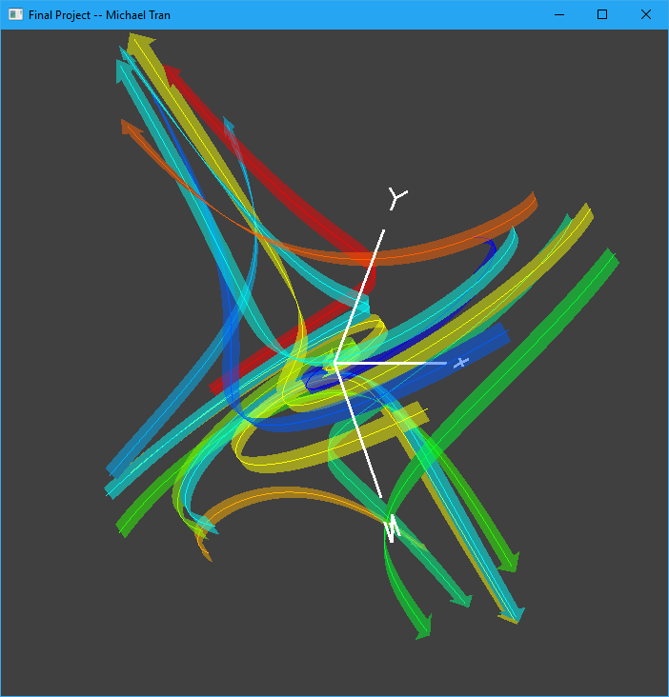
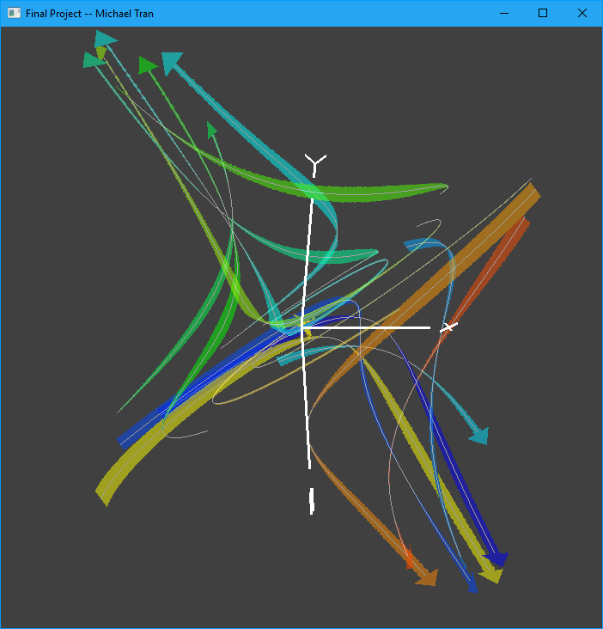
Streamtape Generation - Results
Streamtapes (Without Factoring Torsion)
Streamtapes (With Torsion)

Slide 12
Demo

